Slide 1
Transducer Development

Slide 2
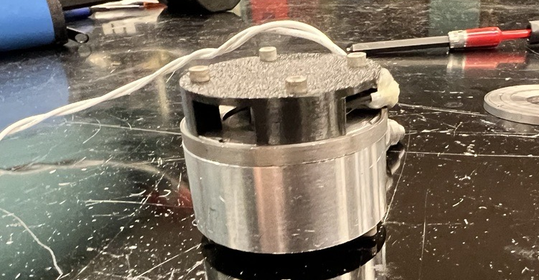
Mechanical Challenge
Build a transducer capable of operating in a marine environment and transmitting a range of frequencies
Solution needs to be simple and tunable to reliably work with modem
Solution must be low cost as current market solutions are quite expensive
Solution must be able of transmitting signals with enough power to achieve desired range

Slide 3

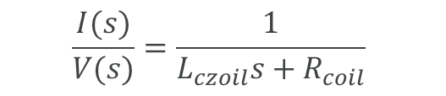
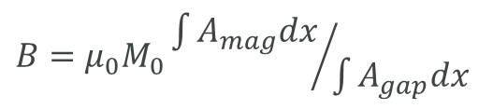
Transducer Fundamentals
Magnetic Force
Magnetic Circuit
Electrical Circuit
B
B
R
I
+
B
F
V
I
r
-
L
$$B={μ_{0}M}_{0}{\int{A_{mag}dx}}/{\int{A_{gap}dx}}$$
$$\frac{I(s)}{V(s)}=\frac{1}{L_{czoil}s+R_{coil}}$$
$$F_{T}=2πN_{coil}r_{coil}×B$$

Slide 4
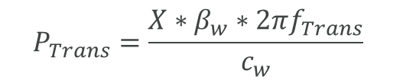

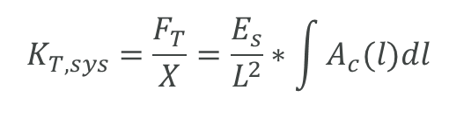
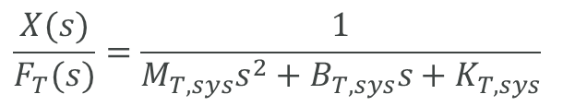
Transducer Fundamentals
Mass – Spring - Damper
Young’s Modulus of Materials
Sound Pressure
P
M
F
A
β
X
X
F
L
B
E
K
F
X
c/f
$$ε=σ/E$$
$$\frac{X(s)}{F_{T}(s)}=\frac{1}{M_{T, sys}s^{2}+B_{T, sys}s+K_{T, sys}}$$
$$K_{T, sys}=\frac{F_{T}}{X}=\frac{E_{s}}{L^{2}}∗\int{A_{c}(l)dl}$$
$$P_{Trans}=\frac{X∗β_{w}∗2πf_{Trans}}{c_{w}}$$

Slide 5
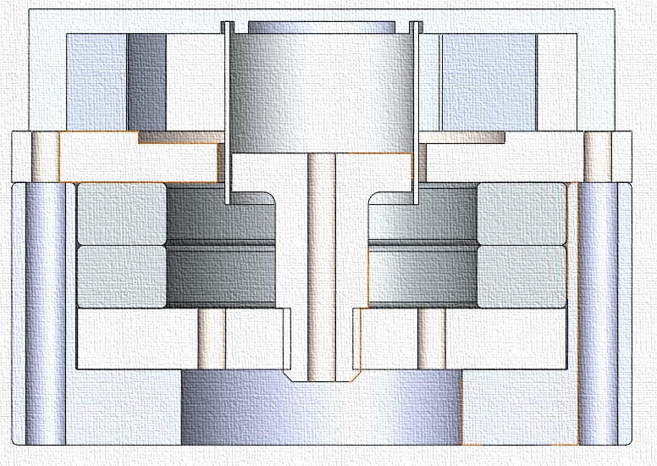
Mechanical Concept
Interchangeable plastic or metal head
Metal voice coil and bobbin
406 Stainless steel magnetic circuit
SmCo Permanent Magnets
6061 Aluminum Structural Enclosure
A coil driven speaker with a flooded core design
  Flooded core eliminates the need for a seal, a common complexity of on the market solutions
Instead of making the design “waterproof” by sealing out the water, the design was “waterproofed” by careful material selection
1
2
4
3
5

Slide 6
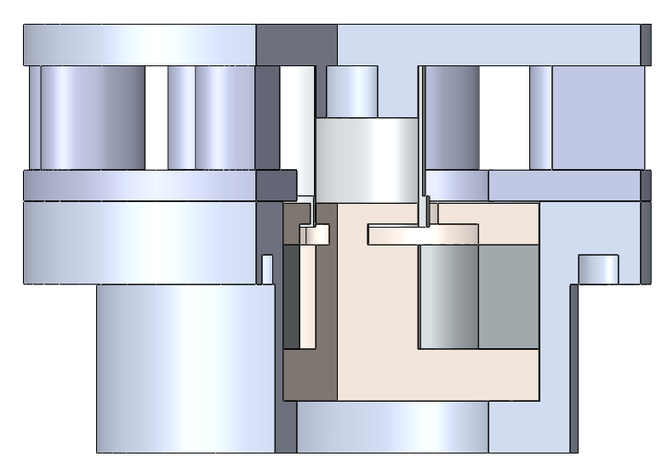
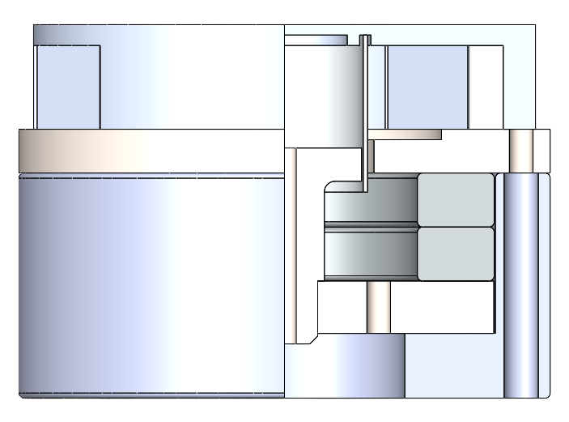
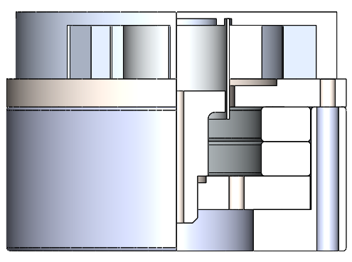
Design Evolution
Mark 0
Development Prototype
Mark 1
Fully Functional Unit
Mark 2
Optimized Final Product
Based on a coil driven speaker
Laminated paper bobbin
3D printed housing
Corroded ferrite magnets
Corrosion resistant construction
Small form factor
Fully manufactured in house
Various head designs
Interchangeable head design
Metal bobbin and housing
Pole piece attachment redesign
More voice coil clearance
Dimensional optimizations
Core drainage holes

Slide 7
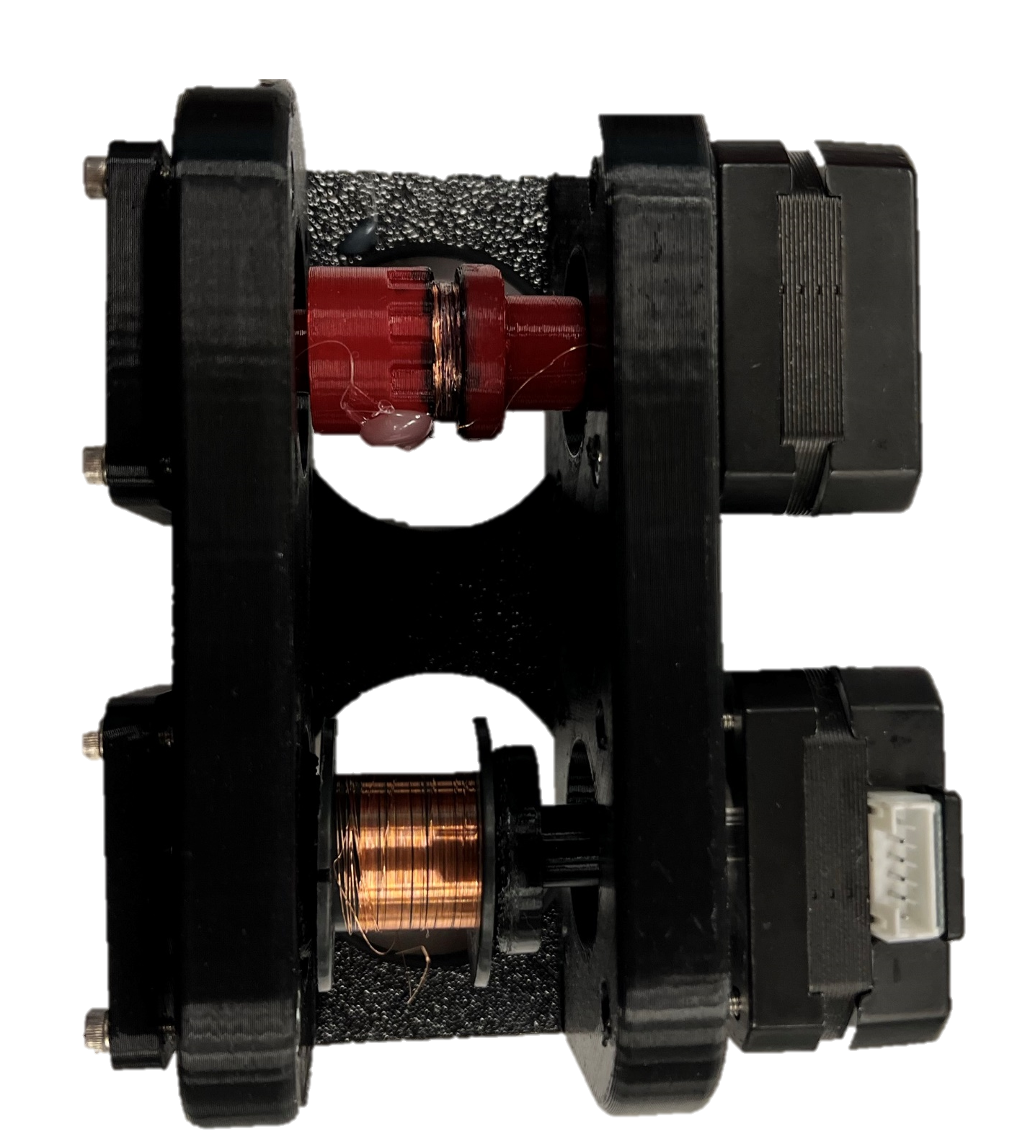
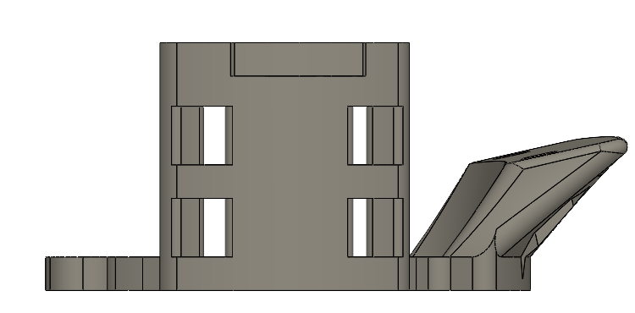
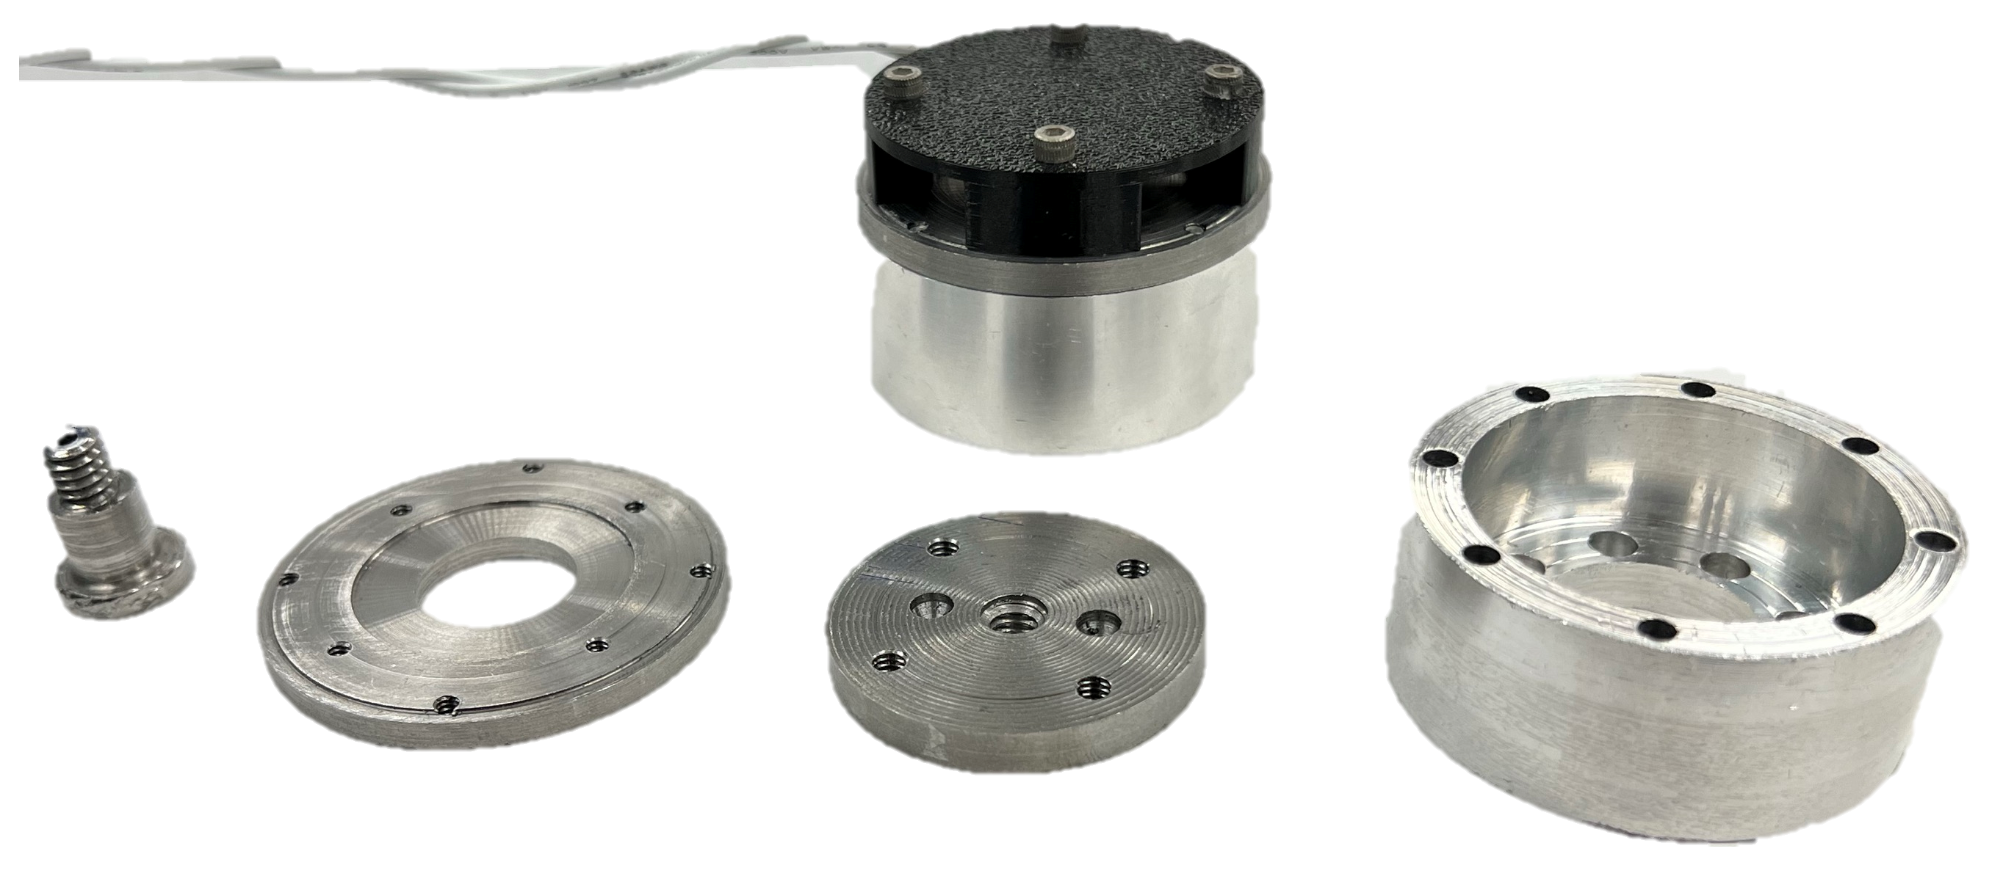
Challenges
Coil Manufacturing
  Constructed the coiler device
Leaning Pole Piece
  Countersank threading in bottom plate
Water Stuck in Core
  Drainage holes added in bottom plate
Coil Leads Ripping
  Tension relief in designed in mount
Magnets Shattering
  Documented cleaning and assembly procedure

Slide 8
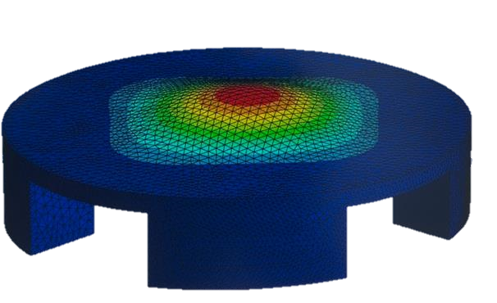
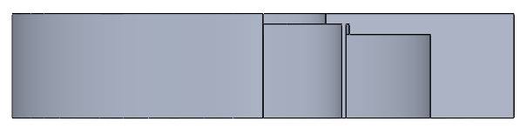
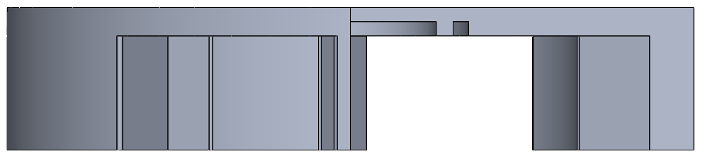
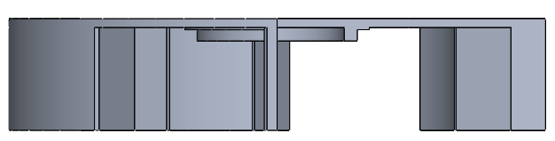
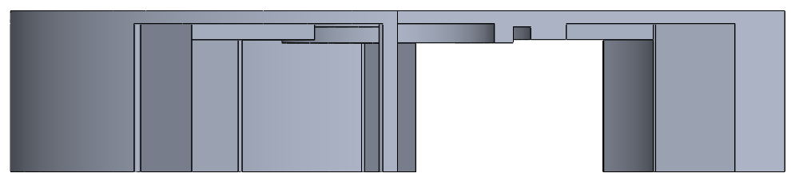
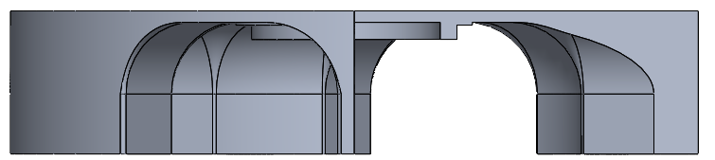
Head Testing and Simulation
Performed Finite Element Simulation to design a head with an optimized resonance frequency.
Various heads used in empirical testing:
Aluminum 6061
Quiet; Resonance: ~17kHz
Plastic: Square
Medium Loud; Resonance: 3.1 khz
Plastic: Thin
Loud; Very Resonance: 1.5 khz
Plastic: Thin Ribbed
Loud; Resonance: 1.5 kHz
Plastic: Thin Filleted
Loud; Resonance 7 kHz
Best Reasonable Aluminum Design: 17kHz
Low Displacement to Force gain with AL 6061 in simulation informed decision to move to plastic.

Slide 9
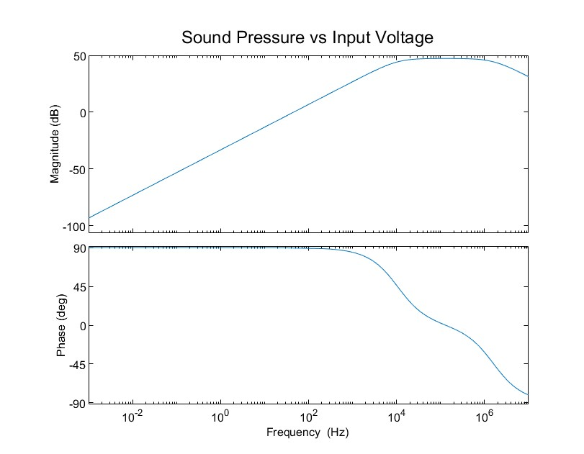

Slide 10
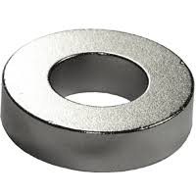
Corrosion Resistance
Construction Materials have Corrosion Resistance
  18-8 Stainless Steel and Aluminum 6061
  If Galvanic Corrosion Noticed, a Zinc Sacrificial Anode can be Added
Magnetic Core is a Corrosion Resistant Ferromagnet
  Samarium Cobalt
Drainage Holes Prevent Stagnant Fluid

Slide 11
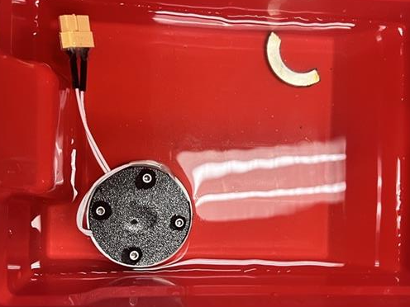
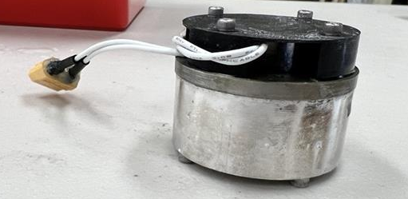
Corrosion Resistance Testing
Ran 72-hour corrosion test in chlorinated water
  Typical pool water sample
Device operational after corrosion bath
  Shown signs of galvanic corrosion but no oxidation
Tested SmCo magnet did not oxidize

Slide 12
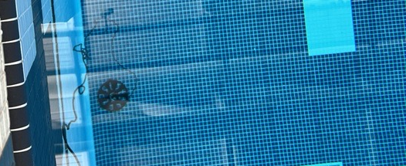
Depth Testing
Successfully proven operational at a depth of 18ft
  Theoretically, due to the flooded core design, the design should be easily capable of the ideal depth rating of 1000 ft.
    No where reasonably available to test
Operation appears to be consistent across depth
  Generally, filtered measurements produce a signal to noise ratio around 4.
Tested Depth (m) | Mean Transmission Amplitude (V)
2 | 3.36
3 | 3.32
4 | 3.40
5 | 3.36
Noise | .65

Slide 13
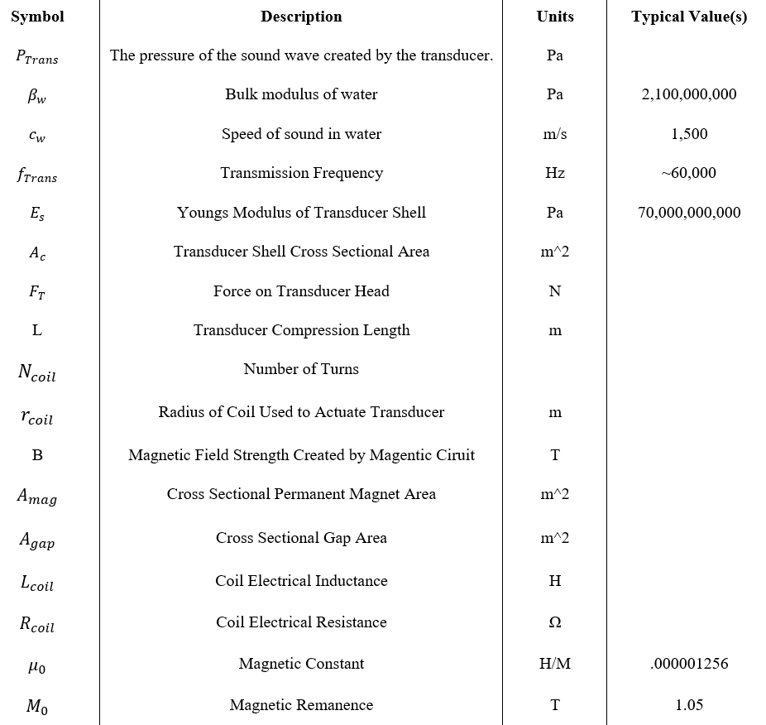
Symbol Definitions

